Slide 1
Project REToken
Fractional Investment of Real Estate
Batch 3 Group 7
Mei Xuan
Soh Har
Travis

Slide 2
OUR VISION, MISSION & VALUE PROPOSITION
VALUE PROPOSITION
MISSON
VISION
Level Playing Field for All Investors in Real Estate Investment
Unleash Value from
Fractional Investment of
Real Estate
Democratize Access to Real Estate Investment

Slide 3
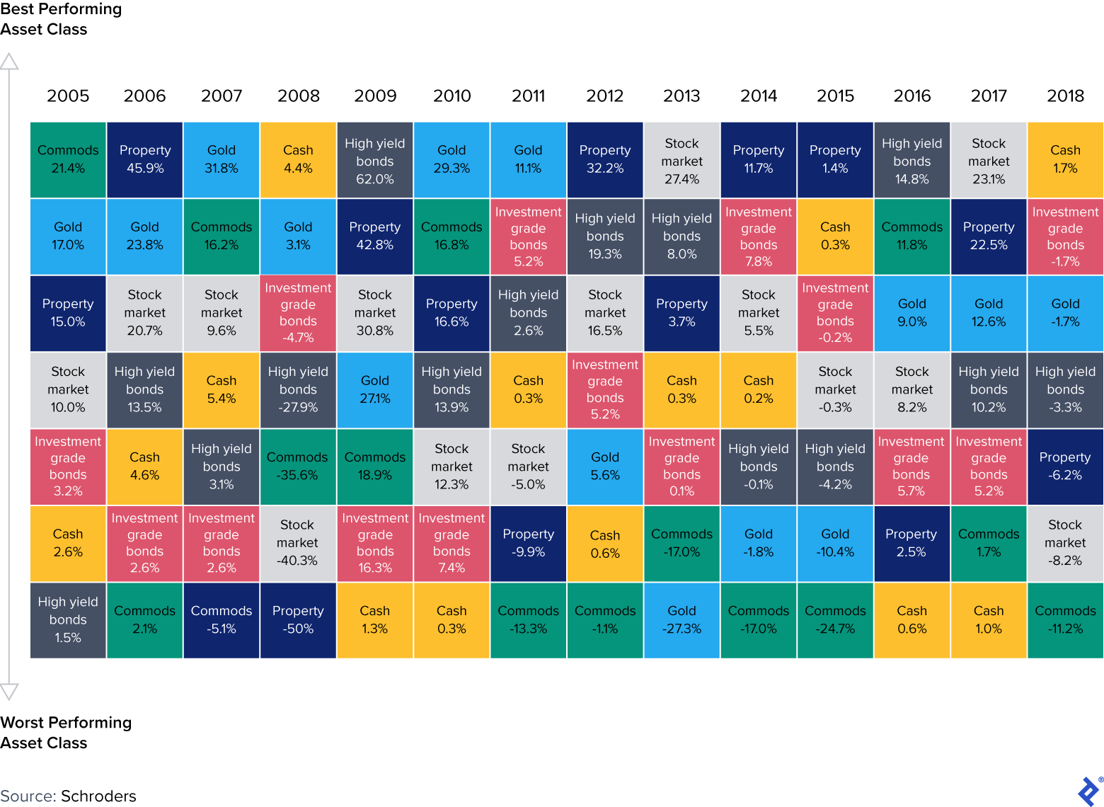
WHY IS WORTH LOOKING INTO IT?
USD 228T
Largest Asset Class
DEMAND
Increasing Appetite for Real Estate Investment
USD 830B
Invested
Notes:
At USD228 trillion (according to RCA), real estate is the largest asset class in the world, it is more valuable than bonds and stocks combined
Despite the enormous market size, global commercial real estate investment only reached USD830 billion in 2019 (according to CBRE), account for only 0.3% of the total asset value
Increasing demand from new investors for increased access and from existing investors for greater liquidity gives an impetus to transform the real estate investment landscape

Slide 4

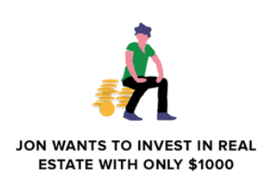
WHAT ARE THE PROBLEMS?
HIGH BARRIERS TO ENTRY
High capital requirements,
not all investors have the same access to information
ILLIQUID ASSET
Real estate is one of the most illiquid asset class
TOO MANY INTERMEDIARIES
Large number of intermediaries
e.g. lawyers, brokers, bankers, financial institution
Notes:
Over 90% of investors in primary market are institutional or accredited investors (according CRE report)

Slide 5
EXISTING BUSINESS MODELS & THEIR EFFECTIVENESS
REITS
Listed Real Estate Co.
Private Investment
Time-consuming listing process
Expensive (10% - 20%)
Not accessible by single asset owners
Some intermediaries
Time-consuming listing process
Expensive (5% - 10%)
Not accessible by single asset owners
Many intermediaries
Opaque Information
Opaque Information
Market Accessiiblity
Illiquid
Regulatory Compliancy
Some intermediaries
Notes:
Large commercial properties are good examples of illiquid assets as each property is unique (lack of standardization) and requires large upfront investment. The transaction period for such investments are long, and once invested the owner tends to hold the asset for a prolonged period due to high transaction costs. A typical timeline from finding a property to closing the transaction can be anywhere from 6 months to 2 years, and the transaction fees range from 1% to 3% of the asset value.
Publicly traded Real Estate Investment Trusts (REITs) are one option of liquid real estate investments. However, the process to offer and list a REIT in most of the established exchanges in the world is time consuming and generally takes more than 2 years of planning. It can also be expensive, with costs ranging from 3% to 10% of the market value of the assets, which translates to costs of up to several million dollars. Using a REIT to provide liquid real estate investment is not a feasible option for owners of a single asset or a small portfolio of assets.
In contrast, tokenization is ideal for owners of a single asset or a small portfolio of assets, due to the significant reduction of time and cost in offering investors the right to participate in fractional ownership and subsequent secondary trading.

Slide 6
IDEAL COMMERCIAL PRODUCT
01
02
03
TOKENIZATION & FRACTIONALIZATION
PRIMARY & SECONDARY MARKET
ADMIN & USER DASHBOARDS
04
05
06
FREE CONSULTATION
MONETIZATION
ECOSYSTEM
Notes:
Enables the fractionalization of the asset, making it more accessible to the mass market and allow the asset owners to issue tokens to the asset for financing purposes
Primary Market (Owner to Investor). Secondary Market (Investor to Investor, provides liquidity for the token holders)
Admin (Provides Admin with direct access to tools for more efficient management), Owner (Provides overview of tokenized assets and pending actions), Investor (Provides one-stop view on investor’s portfolio)
No obligations consultation (online or in-person) to increase awareness and adoption of service
Primary (Tokenization fee, Transaction fee). Secondary (Ads, E.g. Developer, Other alternative investment)
Collaborate and support other services that provide Digital Titles, Digital Leases, Security Token List to allow frictionless onboarding and reduced cost

Slide 7
LASIC PRINCIPLES
Ride on Existing Infrastructure
Avoid Large Fixed Costs
Solves Problems of Existing Business Models
Use of Technology to find Untapped Markets
LOW MARGIN
ASSET LIGHT
SCALABLE
INNOVATIVE
COMPLIANCE EASY
Low Barriers to Entry
Accessible by Single Asset Owners
Easily Penetrating other Asset Markets
Technology allows for Large Scale Adoption & Changes
Use of Existing Regulatory Frameworks
Great Likelihood for Government Support

Slide 8








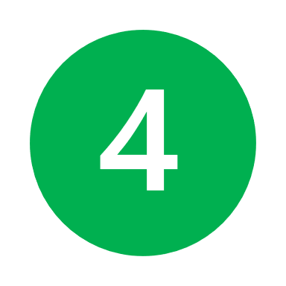
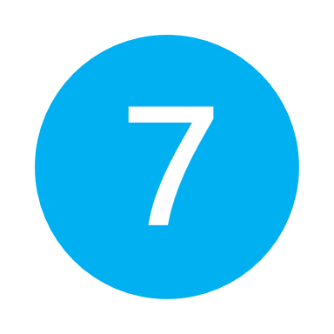
MINIMUM VIABLE PRODUCT
To Date
Validated
KYC/AML
User Dashboard
Monitor
Get Transactions
Onboard
Asset Owner
Marketplace
Monitor
Review
Participate
Create
Validated
Review
Create Asset
Asset Detail
Invest
Onboard
KYC/AML
Pay Owner
Invest
Investor
Deal structure
Initiate
Allot Token
Trade in secondary market
Exchange or Swap
Platform Admin
Issue Token
Participate
Issue Token
Legal service
Valuation service
Create Token
List
Legends
Web App
Smart Contract
Manual Process
Actors
External Actors
Mint Token
USDT
Distribute
RE Manager
Admin Dashboard
Distribute Income
Distribute
Manage
RE Operation
Income
MVP Functions

Slide 9
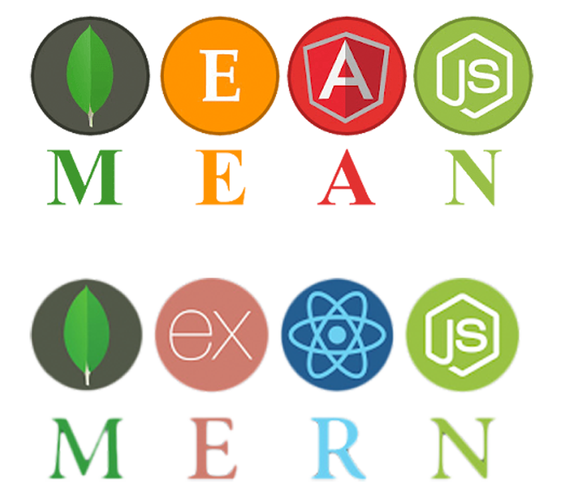


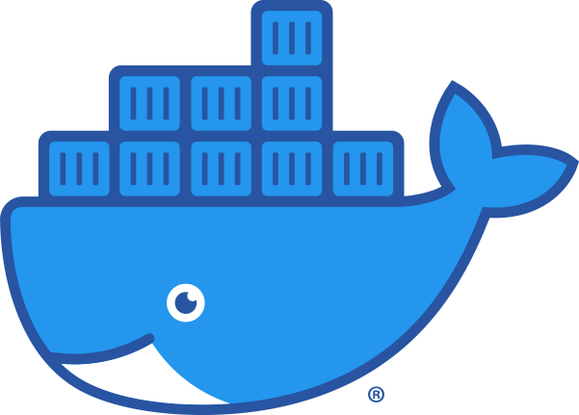

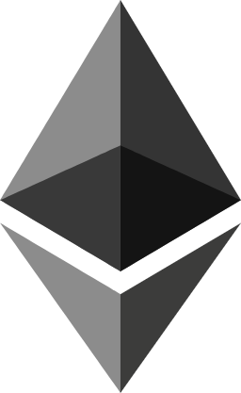

TECH STACK
MERN FULL STACK
GITHUB & DOCKER
HEROKU
MongoDB - Data Store
Express - Server
React JS - Frontend
Node JS - Backend
Code Management
Deployment Management
Cloud Web Hosting
ERC1155 TOKEN
SOLIDITY
OPENZEPPELIN
Smart Contract
Language
Token representing ownership of asset
Token and Upgradeable Contracts Library

Slide 10
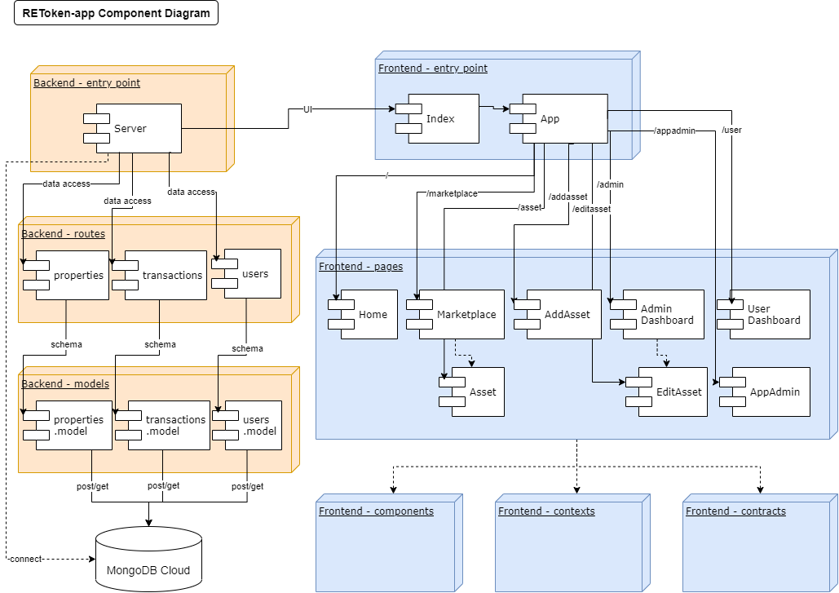
APP COMPONENT DIAGRAM

Slide 11
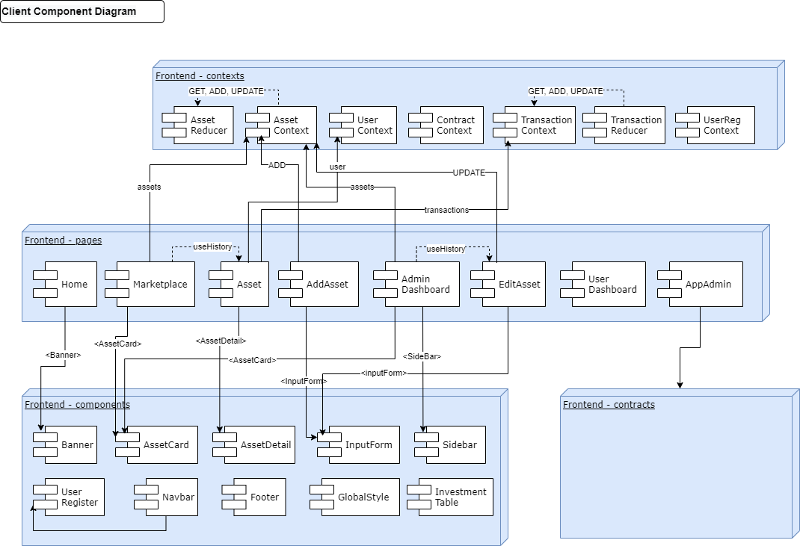
CLIENT COMPONENT DIAGRAM

Slide 12
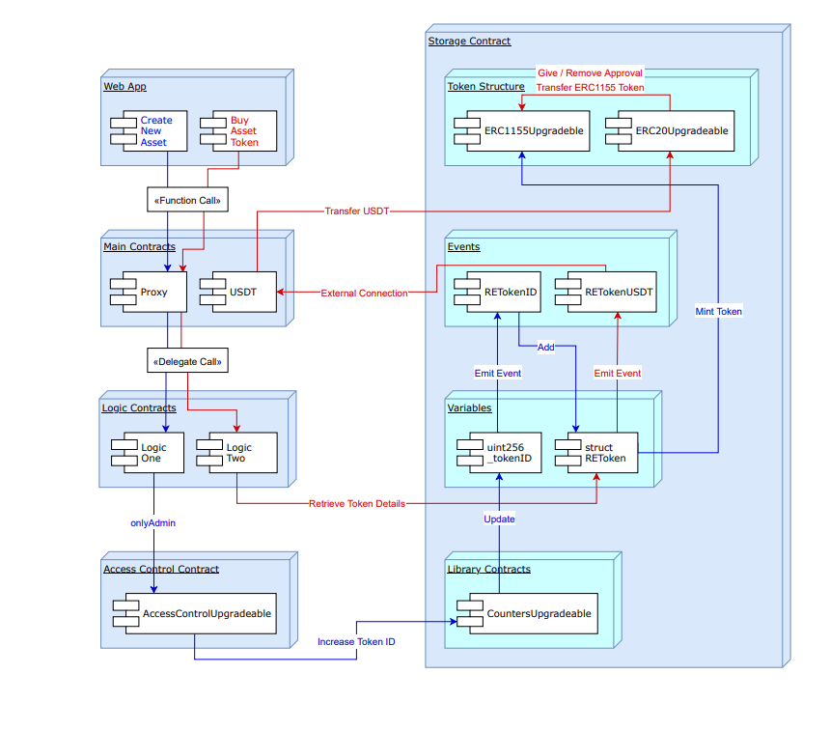
SMART CONTRACT LOGIC DIAGRAM

Slide 13
THANKS
Any questions?

